Slide 1
Charge Up New Jersey – Year 3
Compliance Filing Stakeholder Meeting
June 13, 2022

Slide 2
Meeting Outline
Welcome and Introduction
Meeting Logistics
Process & Schedule for Comments
Overview of Program
Public Comments

Slide 3
Meeting Logistics
Meeting will be recorded. All comments are public.
Registered speakers first.
Use “raise hand” function to request to provide oral comments
Speakers will be unmuted to provide comment; should state name and organization.
Meeting recording, PowerPoint, and comments will be available on the website.

Slide 4
Process & Schedule for Comments
Commenters are encouraged to file their comments directly to the specific dockets, Docket No. QO22020113, using the “Post Comments” button on the Board’s Public Document Search tool.
Comments may also be submitted electronically to Board.Secretary@bpu.nj.gov in PDF or Word format with the subject “FY23 Charge Up New Jersey Program.”
Please note that these comments are considered “public documents” for purposes of the State’s Open Public Records Act. Commenters may identify information that they seek to keep confidential by submitting them in accordance with the confidentiality procedures set forth in N.J.A.C. 14:1-12.3.
Any questions may be submitted via email to Board.Secretary@bpu.nj.gov, with the same subject heading as above.
Comments will be accepted through 5:00 p.m. on June 20, 2022.

Slide 5
Funding & Incentive Summary
Year | Incentives | Funding
Year One - Post Purchase Incentive | 6914 | $33,261,000
Year Two - Waitlisted Post-Purchase Incentives | 1,520 | $7,231,900
Year Two - Point of sale Incentives (Approved) | 3,791 | $12,828,425
Year Two - Point of sale Incentives (Pending) | 1235 | $4,370,850
Total | 13,460 | $57,679,175

Slide 6
Percent of Year Two Applications by Status
Year Two of Charge Up launched on July 6, 2021. As of June 8, 2022, 6,416 applications have been received, and 3,791 incentives have been approved or paid by the Charge Up New Jersey program. Due to its immense popularity, the program stopped accepting applications for EVs purchased, leased, or ordered after September 15, 2021. The following figure (Percent of Year 2 Applications by Status) shows the status of year two applications as of June 8, 2022.

Slide 7
Percent of Incentives by Vehicle Manufacturer
Year One includes all approved incentive applications (N=8,434)
Year Two includes all approved incentive applications and pending applications as of 6/8/2022 (N=5,024)

Slide 8
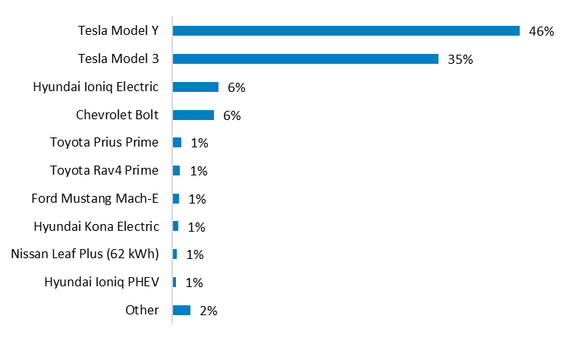
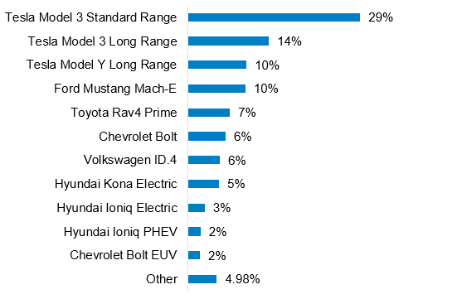
Vehicle Make
Year One – post purchase incentive
Year Two – point of sale incentive
The most popular models incentivized were the Tesla Model Y, Tesla Model 3, Hyundai Ioniq and Chevrolet Bolt.
The most popular models incentivized were the Tesla Model 3, Tesla Model Y, Ford Mustang Mach-E and Toyota Rav4 Prime.
Approved Incentives by EV Model for Remaining Year One Incentives Awarded (N=3,014)
Approved Year 2 Incentives by EV Model (N=3,396)

Slide 9
Year 2
Nearly half (47%) of approved/paid incentives went to EVs eligible for the maximum $5,000 incentive. Due to the institution of the soft MSRP cap, an additional 40% of approved/paid incentives received the lower maximum payment amount of $2,000. The average incentive amount to date is $3,384.
Eligible EV Incentive Amount | Number of Incentives
$5,000 | 1,780
$4,250 | 99
$3,825 | 3
$3,725 | 10
$2,850 | 25
$2,750 | 1
$2,000 | 1,527
$1,175 | 4
$1,050 | 247
$925 | 1
$725 | 75
$625 | 14
$600 | 1
$575 | 2
$550 | 2
Year Two includes all approved incentive applications as of 6/8/2022 (N=3,791)

Slide 10
Percent of Incentives by County
Year One includes all approved incentive applications (N=8,434)
Year Two includes all approved incentive applications as of 6/8/2022 (N=3,789)

Slide 11
Staff Recommendations
Year Two
Plug-In Electric or Plug-In Hybrid Vehicle
Must be purchased or leased in the State of New Jersey
Must be registered in NJ to a NJ licensed driver
MSRP must be less than $55,000
$25/emile up to $5,000 for vehicles with MSRP under $45,000
$25/emile up to $2,000 for vehicles with MSRP between $45,000-$55,000
Point-of-Sale Incentive
Purchased after the FY22 launch until funding is exhausted
Proposed Year Three *
Plug-In Electric or Plug-In Hybrid Vehicle (PHEV until December 31, 2022)
Must be purchased or leased in the State of New Jersey
Must be registered in NJ to a NJ licensed driver
MSRP must be less than $55,000
$25/emile up to $4,000 for vehicles with MSRP under $45,000
$25/emile up to $2,000 for vehicles with MSRP between $45,000-$55,000
Point-of-Sale Incentive
Purchased after the FY22 launch until funding is exhausted
* On May XX NJBPU released a Straw Proposal outlining the Year 3 Incentives. Comments are due on June 20,2021. Final requirements and incentive levels will be included in the Board’s FY23 Budget.

Slide 12
Staff Recommendations
Consumer Protections
No additional Charges, Mark-ups, Payment contingencies or holds.
Full incentive must be applied at the point of sale.
Incentive may not be held until application is approved or issued as a check after the transaction is completed.
Dealerships and Showrooms may not recuperate the value of the incentive from a customer in the event that an application is cancelled due to Dealership or Showroom error or penalty.

Slide 13
Staff Recommendations
Vehicle Orders
Vehicle must be ordered after the program opens.
Weekly order numbers and delivery dates.
Order date is the date that money is put down on the vehicle.
Suggest dealers collect license, signed terms and conditions (note this may need to be updated at time of delivery).

Slide 14
Staff Recommendations
Residential Charger Program
Incentive for $250.
Recommended Documents required for Phase Three Application Process by Applicants:
Proof of purchase of a Level-Two smart charger for residential use;
Scanned photo of the serial number on the charging equipment;
New Jersey Driver’s License as proof of residence and a unique identifier;
Proof of Installation of the charger;
Validation: One Charger Incentive per NJ Address (including one per apartment in a Multi-Unit Dwelling); and
Validation: Each applicant (tracked by their New Jersey Driver’s License) may receive up to two charger incentives throughout the duration of the 10-year Charge Up New Jersey Program, but no more than one per address.

Slide 15
Public Comments

Slide 16
Thank You!

